Slide 1
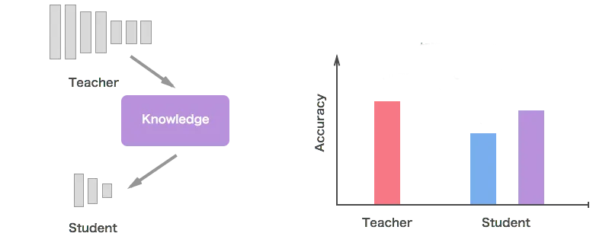
Knowledge Distillation on Neural networks
- Poornima Devi Krishnasamy Karthikeyan -

Slide 2
Contents :
Introduction
Knowledge Distillation (KD)
Types of Knowledge Distillation
Knowledge Distillation Schemas
Methodology
Terms
Hybrid approach
Loss function
Dataset information
Implementation :
Teacher model – Resnet5O
Student model – Resnet18
Hyperparameter tuning
Student model without KD
Results

Slide 3
Introduction:
Problem:
Large deep learning models → high accuracy and cost. Real-world deployment → smaller, faster models.
Goal :
Knowledge distillation → lighter models for resource constraint deployment without losing the performance.
Transferring knowledge from a large model ( Teacher) to a small model (Student).
Notes:
To Train a lightweight student model (ResNet30) to mimic a larger teacher (ResNet50) using Knowledge Distillation. Compare performance with and without student KD.
, having large amounts of parameters makes the models high memory demanding
drawback of such wide and deep models is that they result in very time consuming systems at inference time, since they need to perform a huge number of multiplications.
top-performing systems usually involve very wide and deep networks, with numerous parameters
The importance of depth has been verified (1) theoretically: deep representations are exponentially more expressive than shallow ones for some families of functions

Slide 4
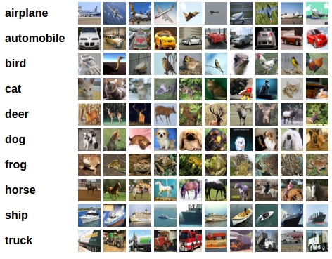
Dataset Information:
CIFAR-10 :
5000 training images
1000 validation images
2 x 32 x 32 images
10 classes

Slide 5
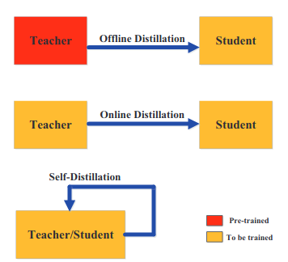
Knowledge distillation schemes:
Offline distillation method is used for the further implementation of KD
Notes:
Offline distillation
Online distillation
Self distillation
There are three principal types of methods for training student and teacher models, namely offline, online and self distillation. The categorization of the distillation training methods depends on whether the teacher model is modified at the same time as the student model or not
Offline distillation is the most common method, where a pre-trained teacher model is used to guide the student model. In this scheme, the teacher model is first pre-trained on a training dataset, and then knowledge from the teacher model is distilled to train the student model. Given the recent advances in deep learning, a wide variety of pre-trained neural network models are openly available that can serve as the teacher depending on the use case. Offline distillation is an established technique in deep learning and easier to implement.
To address this limitation, online distillation can be used where both the teacher and student models are updated simultaneously in a single end-to-end training process. Online distillation can be operationalized using parallel computing thus making it a highly efficient method.
the same model is used for the teacher and the student models. For instance, knowledge from deeper layers of a deep neural network can be used to train the shallow layers. It can be considered a special case of online distillation, and instantiated in several ways. Knowledge from earlier epochs of the teacher model can be transferred to its later epochs to train the student model.

Slide 6
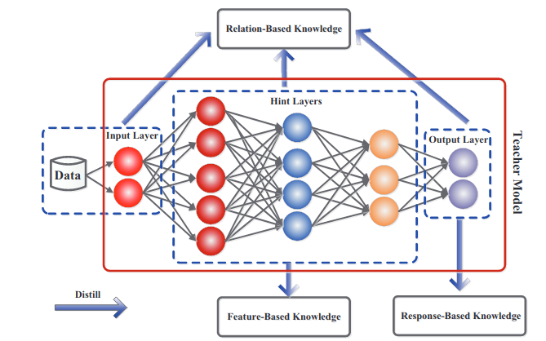
Types of Knowledge Distillation:
Notes:
FitNets, to compress wide and shallower (but still deep) networks. The method is rooted in the recently proposed Knowledge Distillation (KD) (Hinton & Dean, 2014) and extends the idea to allow for thinner and deeper student models. We introduce intermediate-level hints from the teacher hidden layers to guide the training process of the student, i.e., we want the student network (FitNet) to learn an intermediate representation that is predictive of the intermediate representations of the teacher network.
Hints allow the training of thinner and deeper networks
Results confirm that having deeper models allow us to generalize better, whereas making these models thin help us reduce the computational burden significantly.
Response based KD – student learns to mimic the output predictions of the teacher model , this is done by minimizing the difference between the predicted outputs of the teacher and student , the primary focus here is on the logits the raw outputs scores before applying the softmax functions produced by the teacher model , this is straightforward since it only requires the output of the teacher model ( does not capture the internal representations or features learned by the teacher model)
Feature based KD – transforms knowledge from the intermediate layers of the teacher model to the student model , this involves using the putputs of hidden layers from the teacher to guide the student in learning similar representations , so by leveraging the intermediate features this method allows the student to learn more complex representations ( student model can generalize well especially from a limited data ) may have high cost since we need to extract info from every iterations
Relation based KD – focuses on capturing the relationships between different inputs and their corresponding outputs , this method trains the student model to understand the relational knowledge present in the teacher model which can include interactions between different feature maps or the dependencies between various outputs by learning the relationships between the features this student model can develop more contextual understanding of the data ( relative similarities ) Relative similarities: Comparisons between classes , This teaches the structure of relationships rather than just the end probabilities!

Slide 7

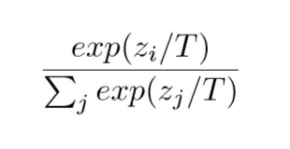
Methodology : Terms
Softmax :
raw logits → probability distribution [0.95, 0.02, 0.01, 0.01, 0.01] → Not informative beyond the top prediction.
Temperature ( T ) :
Softens the probability output from softmax [0.85, 0.05, 0.04, 0.03, 0.03]
Higher T → softer, more informative distribution
Notes:
The value of T impacts the distillation , if you have inapproatiate of value of T (which you could destroy your information ) then it not only distills the impurities but also the desired elements of it. This value is found with experimentation so its one of the hyperparamter

Slide 8
Methodology : Terms
Soft Labels :
Teacher's output probabilities [0.4, 0.3, 0.2, 0.1] → richer info than just the correct class.
Hard Labels :
One-hot true labels [1, 0, 0, 0]) → standard classification loss
Alpha (α ):
Controls the balance between:
Distillation loss (soft labels)
Classification loss (hard labels)
Notes:
knowledge distillation, alpha (α) is a hyperparameter that controls the balance between two loss functions: the student's loss on the ground truth labels (often cross-entropy) and the distillation loss (often KL divergence) comparing the student's soft predictions with the teacher's soft predictions. Essentially, it determines how much emphasis is placed on learning from the teacher's "knowledge" versus learning from the true labels.

Slide 9
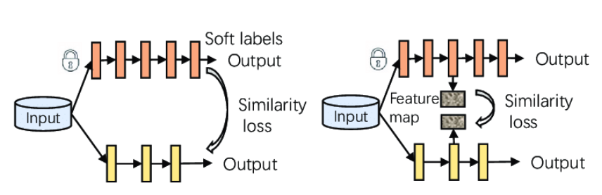
Methodology - Knowledge Distillation (KD):
Model architecture:
Teacher : large pre-trained model (ResNet50) + fine tuned to CIFAR 10
Student : (ResNet18)
How I trained my student model :
Hybrid Approach = response based KD + feature based KD
soft outputs→ teacher
Align intermediate features → representation alignment
Hard labels → student
Feature based KD
Response based KD
Notes:
To Train a lightweight student model (ResNet30) to mimic a larger teacher (ResNet50) using Knowledge Distillation. Compare performance with and without student KD.
This is typical in knowledge distillation:
The teacher is a larger, pretrained model (ResNet50 pretrained on ImageNet).
The student is a smaller model trained from scratch, learning both from the hard labels and the teacher’s soft outputs and intermediate features.
This way, the student can potentially reach better performance than training alone because it learns extra knowledge from the teacher.
Student wrapper :
StudentWrapper is a custom wrapper class around the student model.
It uses the projection layers to align student features to teacher feature shapes during forward passes.
Moving this wrapper to the device makes sure all model components are on the same device.
Note :
# Use defaults T=5.0, alpha=0.7
loss = distillation_loss(student_logits, teacher_logits, targets)
# Override with your own values
loss = distillation_loss(student_logits, teacher_logits, targets, T=3.0, alpha=0.9)
So, hard labels help the student not just imitate the teacher, but also stay grounded to the actual correct answers.

Slide 10
Methodology – Loss function
Loss Components:
Distillation Loss: KL divergence loss
Classification Loss: Cross entropy loss
Feature Loss: MSE
Total Loss: ℒ = α × Distillation Loss + (1 − α) × Classification Loss + 0.1 × Feature loss.
Hyperparameters:
Temperature: 𝑇
Weight Balance: α
Feature Weight: λ = 0.1
Notes:
Reference : https://arxiv.org/abs/1412.6550
KL divergence : measures how one probability distribution diverges from others
KL divergence equals zero when the student’s distribution matches the teacher’s exactly: This gives a clear zero-loss condition when the student perfectly aligns with the teacher.
The KL-divergence is nicer as a loss since it will equal 0 when the student network matches the teacher on all labels. In contrast, if we use X-entropy, then the loss will fluctuate even when the student and teacher output the exact same thing, and it will fluctuate according to the batch, as you described
Distillation Loss: A measure of how well the student mimics the teacher’s soft targets.
Classification Loss: A traditional cross-entropy loss using hard labels
MSE : Teacher and student feature maps are just tensors (vectors/matrices).
MSE is the simplest and most effective way to measure element-wise difference between two tensors.
Cross entropy loss is the same thing as KL divergence
off by a constant. The constant is the entropy of the target distribution, which behaves like a constant because the target distribution is fixed. Because the gradients of this constant are 0, this means that it does not affect the optimization procedure as it does not contribute to the parameter updates.
Note that the entropy of a one-hot distribution is 0, so for one-hot vectors the KL = X-entropy. The reason they are separated in most libraries is because you can compute the X-entropy of a one hot vector slightly faster than the KL since you only need to compute the log-softmax of one of the logits.
The KL-divergence is nicer as a loss since it will equal 0 when the student network matches the teacher on all labels. In contrast, if we use X-entropy, then the loss will fluctuate even when the student and teacher output the exact same thing, and it will fluctuate according to the batch, as you described
Total loss = α × Distillation Loss + (1 − α) × Classification Loss + 0.1 × Feature loss.
q(i) is the probability of class i according to the true distribution (which is typically one-hot encoded), and p(i) is the probability of class i according to the predicted distribution.
Knowledge distillation (KD) has been widely used in different tasks as a practical model compression technique. Due to the poor performance of directly using Mean Square Error (MSE) between the intermediate features of the teacher and student, most feature-based detector distillation methods are primarily concerned with proposing diverse attention mechanisms and employing MSE to guide the student in learning critical information. However, the significance of MSE in detector distillation is often overlooked.
Teacher Model → High Accuracy Predictions (Soft Targets) + Teacher Features
Student Model → Learns from:
→ Soft Targets (ℒ_distill)
→ Hard Labels (ℒ_class)
→ Teacher Features (ℒ_feature)

Slide 11
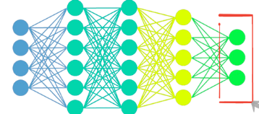
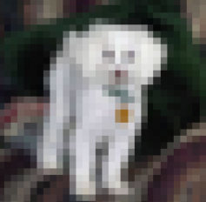

Implementation – Teacher model
Accuracy : 85 %
Soft targets
Feature representations
Input → ResNet50 (Teacher) → extracts Soft Targets + Intermediate Features information
Notes:
student_channels = [64, 128, 256, 512]
teacher_channels = [256, 512, 1024, 2048]
To enable feature-level distillation between the teacher and student models, we introduce a set of projection layers. These layers are used to align the dimensionality of the teacher's high-dimensional feature maps (e.g., 2048 channels) to match the student's lower-dimensional feature maps (e.g., 512 channels).
Specifically, we define projection layers using a custom module (FeatureProjector) for each corresponding pair of student and teacher layers. These layers are trained to transform the teacher’s features so that they can be compared directly with the student’s using MSE loss during distillation.
For each layer, you're creating a FeatureProjector that maps teacher's feature map (high dim) → student's feature map (low dim).
Likely, your FeatureProjector is something like a 1×1 conv or a linear layer:
You are selecting 4 intermediate layers from both the student and teacher models for feature-level distillation.
A 1×1 convolution is just a linear transformation applied independently at every spatial location (pixel) in the feature map.
It doesn’t mix spatial information, only channel information.

Slide 12
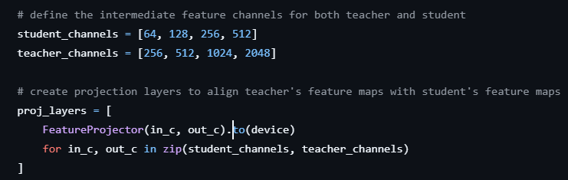
Implementation – Teacher → student
Teacher → student : after projection → [ 64,128,256,512]
FeatureProjector → class aligns the teacher’s feature maps to the student’s feature map.
1x1 conv to project teachers features from in_channels ( teacher channels ) down to out_channels ( student channels ) , to match the channel dimensions.
Notes:
Spatial alignment
Teacher and student feature maps might have different spatial sizes (height × width), e.g., teacher’s feature map might be 14×14, student’s might be 7×7.
You use F.adaptive_avg_pool2d to resize the teacher’s feature map to the student’s spatial dimensions, preserving important spatial information by averaging.
Channel alignment
Teacher’s features typically have more channels than student’s.
You use a 1×1 convolution (nn.Conv2d) to project the teacher’s features from in_channels (teacher channels) down to out_channels (student channels). This matches the channel dimension.
Input: x is a feature map tensor from the teacher with shape [batch_size, in_channels, H_teacher, W_teacher].
target_shape is the feature shape from the student, e.g., [batch_size, out_channels, H_student, W_student].
First, if spatial sizes differ, resize x to (H_student, W_student) with adaptive average pooling.
Then, apply the 1×1 convolution to change channels from in_channels → out_channels.
Return the projected feature map, which now matches the student’s feature shape.

Slide 13
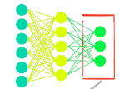
Implementation – student model tuned
Accuracy : 78.6 %
T = t
Soft outputs
Distillation loss
Feature loss
T = t
Soft predictions
T = 1
Hard predictions
CE loss
Hard labels
Input → ResNet18 → learns from soft targets + feature loss ( intermediate features ) + hard labels

Slide 14
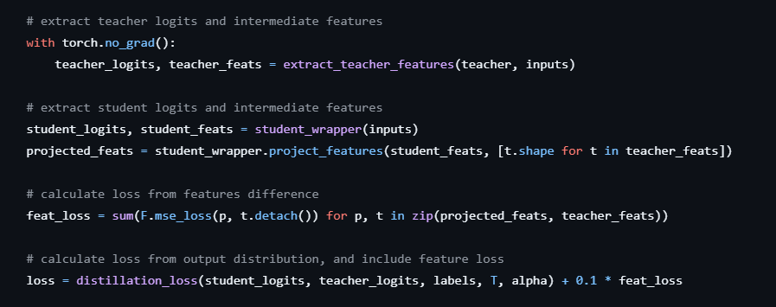

Slide 15
Hyperparameter tuning :
Tuning → two ways
T , α fixed values.
T , α scheduling through exponential decay
Hyperparameter ( fixed ):
T = 0.5
α = 0.7
Hyperparameter ( scheduling ) :
T = 0.5,0.3, 0.95
α = 0.8, 0.5, 0.95
scheduling improved the model accuracy than fixed values
Notes:
A higher alpha (e.g., 0.8) emphasizes the distillation loss, which is great when the teacher’s soft labels are highly reliable.
A lower alpha (e.g., 0.5) relies more on hard labels, which can help if the teacher isn’t perfect.
This might surprise you, but the temperature value in KD doesn’t just control the softening of probabilities — it can significantly influence how well your student learns from the teacher. Here’s what worked for me:
A low temperature (e.g., 1 or 2) tends to make the teacher’s outputs sharper, which can sometimes be too strict for the student.
A higher temperature (e.g., 3 to 5) smooths the teacher’s predictions, making it easier for the student to capture subtle patterns.
Alpha (α)
High (e.g., 0.8): Focuses on soft labels — useful when the teacher is reliable. How do you know teacher is reliable or not
Low (e.g., 0.2): Emphasizes hard labels — better if the teacher isn’t perfect. How you know its perfect or not
Temperature (T)
Low (1–2): Sharp outputs — can be too strict.
High (3–5): c.

Slide 16
Implementation – student model without KD
Accuracy : 76.8 %
softmax
Prediction
Input → ResNet18 (trained from scratch ) → predictions ( cross entropy loss )

Slide 17
Results :
Model | Architecture | Accuracy (%) | Parameters ( M ) | Latency (ms)
Teacher | ResNet50 | 85.11 | 23.5 | 8.72
Student distilled ( tuned ) | ResNet18 | 78.6 | 11.18 | 3.90
Student distilled | ResNet18 | 76.8 | 11.18 | 4.10
Student without KD | ResNet18 | 75.06 | 11.18 | 4.70

Slide 18
Thank you.

